Slide 1



Cura personalis as the antidote to panicked, paranoid, and positively frazzled students through School of Communication (SoC) advising, internships, and in the classroom
Ashley Gisiger, Academic Advisor
Cheryl McPhilimy, Senior Instructor
Pamela Morris, Associate Professor
Notes:
PM

Slide 2
Introductions and Welcoming Activity
Please share your name, position, and one word response to:
How are you ramping up for the spring 2022 semester?
Notes:
CM

Slide 3
Session Agenda:
Collaborating as faculty and staff to support students through the internship process
The SoC Internship process is one way to show our care for the whole person
Key takeaways
Discussion and questions
Notes:
AG

Slide 4
SoC Internship History:
Required 3 credit hour experience for Advertising & Public Relations, Advertising Creative, Film & Digital Media, and Multimedia Journalism majors
Optional for major credit for Communication Studies and Advocacy and Social Change majors
Valued as part of curriculum because experience matters—students have to start somewhere, and we want them to get that experience as undergrads
Simply put, the more successful students are in this process, the more successful they will be in life after Loyola
Supported by academic advising and an internship coordinator team that are all practitioners
We believe all this to be true because here's the reality....
Notes:
AG

Slide 5

Notes:
PM

Slide 6
Internship Preparation & Experience is...
Life & Career Preparation:
Tuition dollars and valuable time are going into this experience—make it worth
Practice for actual employment search, understanding of values
Recipe for interactions in the future
  From emails asking about the process through the search, experience, and an update email to a former supervisor, we are expecting students to take ownership and develop as students and professionals through this experience.
Three Phases:
  Advising
  The SoC Process
  Experiential and Academic Coursework
Notes:
PM

Slide 7
Advising
Junior/Senior standing with 18 credit hours earned in major
Explanation of process, but advising does not approve experiences
  Hand-off to internship coordinators encourages ownership in process
We are gate-keepers for each other
  Stay in touch regarding students through process
  Set and maintain orientation dates and packet deadlines
  Clarity in timeline helps all everyone especially the students
Notes:
AG

Slide 8
The SoC Process
Orientation for everyone—sets the stage for search and experience
Approval process, enrollment by SoC
Include details on hybrid/in-person—how these experiences differ and what they can support the students' growth
Packet is contract
Expectation setting
Notes:
PM

Slide 9
Experiential and Academic Coursework
Use class time in ways that directly impact their lives and add to their real-world skillset
Connections
  Connect to each other class
  Send a thank you email right now
  Put a date on calendar now for future fill-in with former internship supervisor and memory
  Specifically state "Keep in touch with me" "Let me know _______"
Some additional ideas ...
Notes:
CM

Slide 10

Take a thermometer reading

Slide 11

Explain presence as a way to show care and respect for peers

Slide 12

Practice professional introductions
Role
Who you serve (or want to)
How
One sensory detail
One hint of emotion

Slide 13

Purpose
Process
Payoff

Slide 14
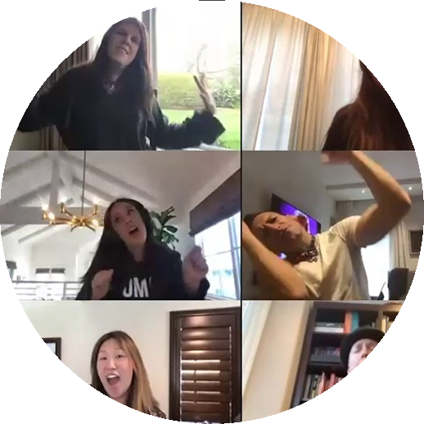
Launch a 30-second dance break

Slide 15

Build a safe practice space with a class LinkedIn group

Slide 16

Like Bomb Someone
LinkedIn
Instagram
Zoom chat

Slide 17
Key Takeaways
Coach students to be efficient with valuable time—ours and theirs—now and in future careers
Team up at all touch points for holistic approach
Notes:
AG

Slide 18

Time for Discussion & Questions
THANK YOU!
Ashley Gisiger
Agisiger@luc.edu
Pam Morris
Pmorris1@luc.edu
Cheryl McPhilimy
Cmcphil@luc.edu
Notes:
Together

